Slide 1



Aula 7 -Carlos Felippe
View in Power BI
Last data refresh:
31/03/2021 21:55:26 E. South America Standard Time
Downloaded at:
31/03/2021 22:22:36 E. South America Standard Time

Slide 2
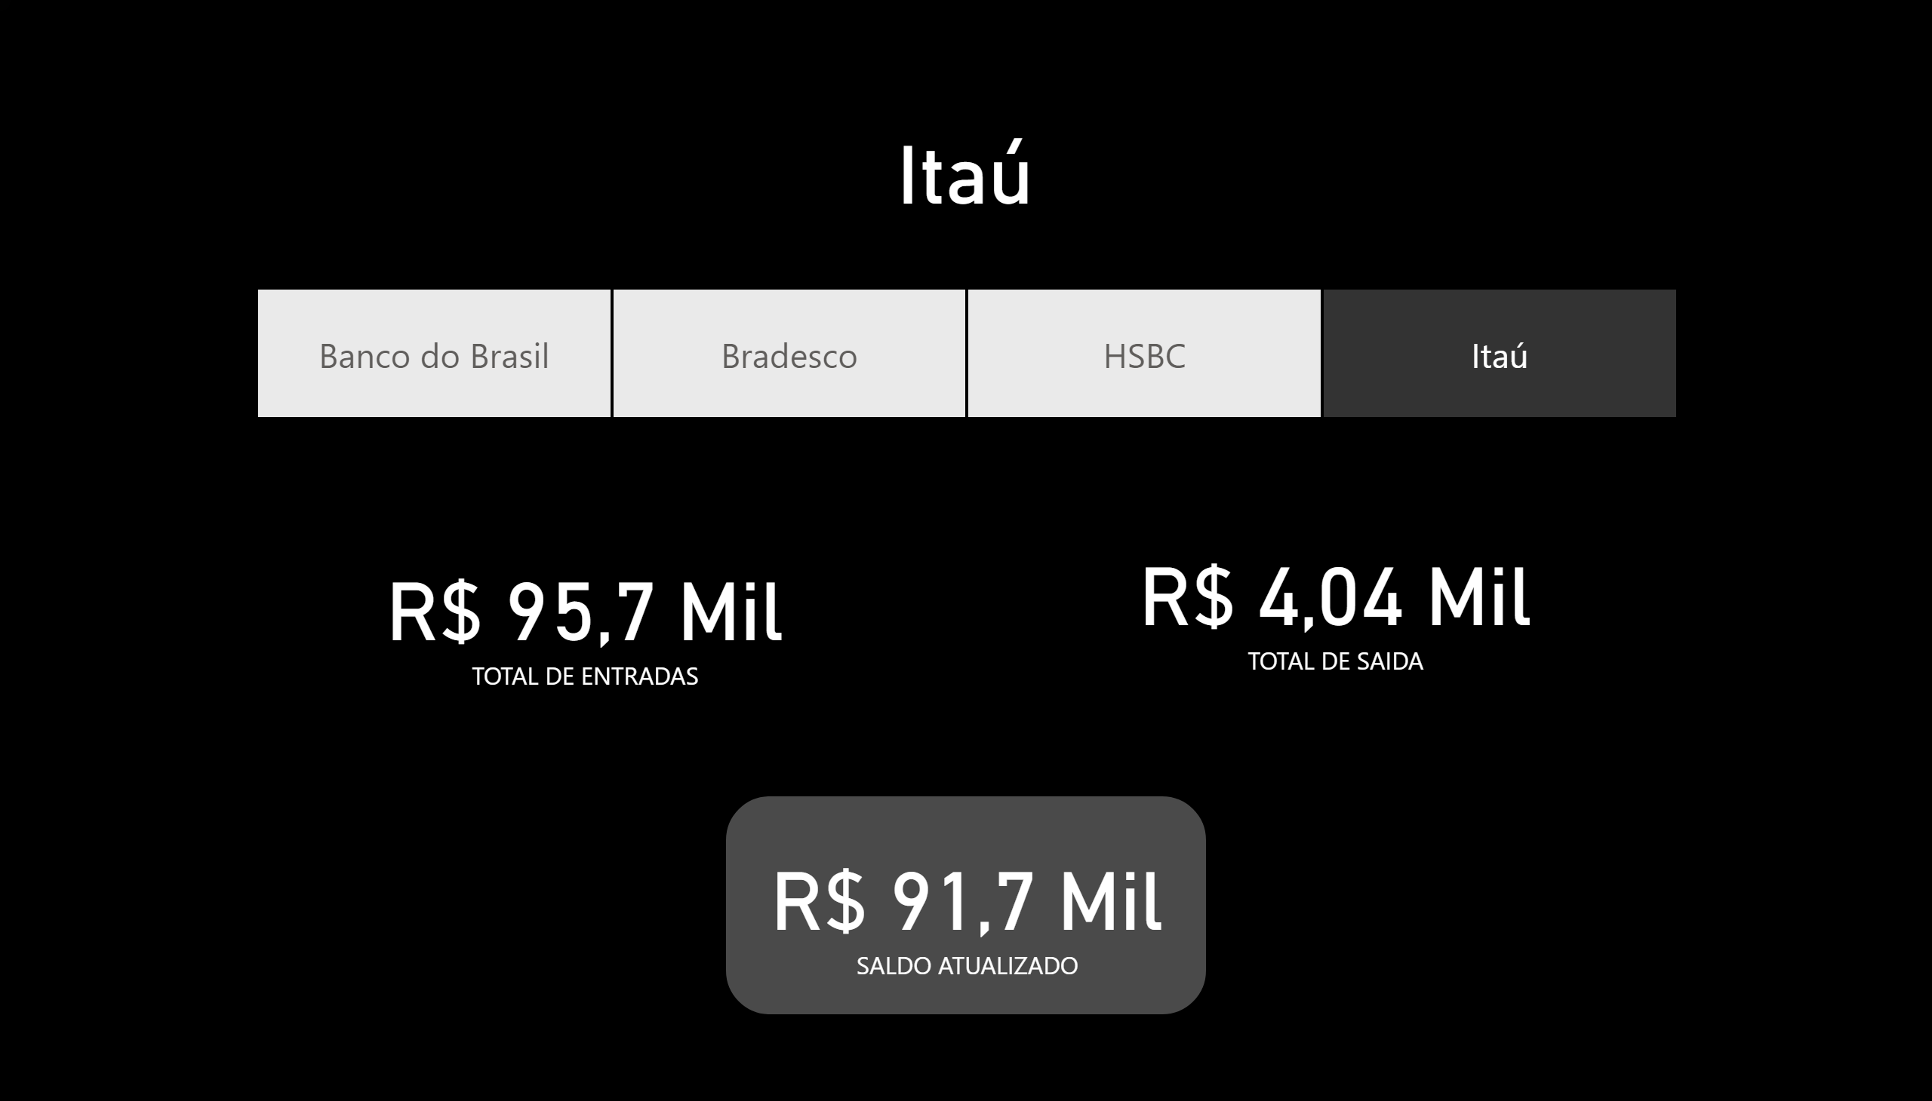
BANCOS
Notes:
card
No alt text provided.
slicer
No alt text provided.
card
No alt text provided.
card
No alt text provided.
card
No alt text provided.

Slide 3
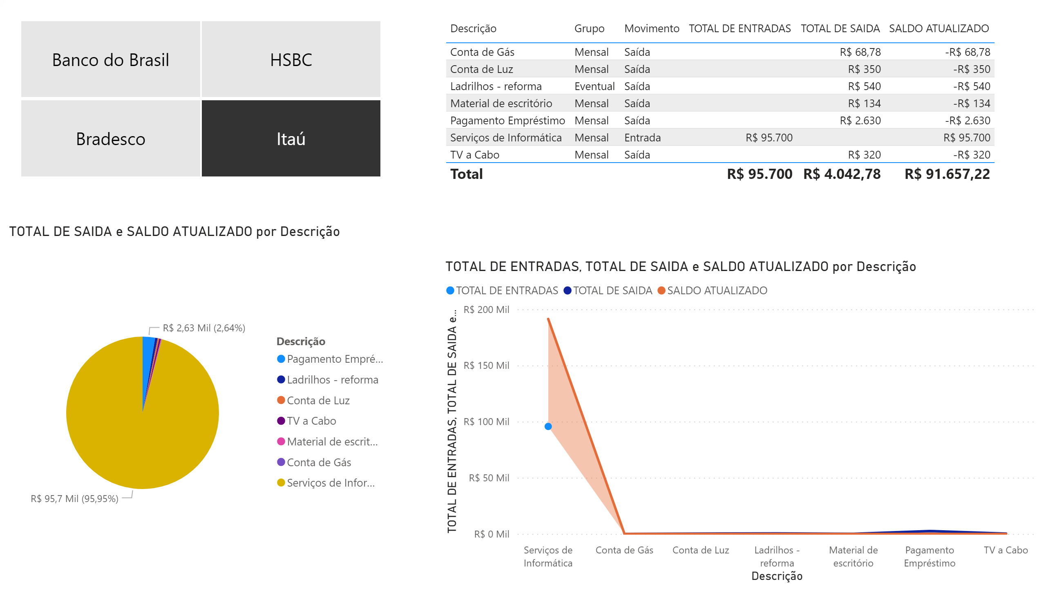
MOVIMENTAÇÃO
Notes:
slicer
No alt text provided.
pieChart
No alt text provided.
tableEx
No alt text provided.
stackedAreaChart
No alt text provided.

